Slide 1
Potato Disease Detection Using Machine Learning

Slide 2
ABSTRACT
Our main goal is to diagnose potato disease using leaf pictures that we are going to do through advanced machine learning technology. This paper offers a picture that is processing and machine learning based automated systems potato leaf diseases will be identified and classified. Image processing is the best solution for detecting and analyzing these diseases.

Slide 3
EXISTING SYSTEM
F. T. Pinki et.al. dealt with the order of three basic paddy leaf sicknesses ( Leaf impact, Brown spot, and Bacterial curse) and taught manures or pesticides k-implies grouping is utilized for the division of the illness affected part and Visual substance are utilized as highlights during this framework. At that point Support, vector machine classifier does the characterization cycle. The general precision is 92.06%.

Slide 4
The system proposed by Yao et.al., is aimed at identifying and classifying three types of rice crop damage. In his figure the diseased regions are isolated using the Otsu’s method, then divided. The first picks up the tone, shape and surface features, and the second came from HSV shading space. And finally, the properties are submitted to the vector machine, which classifies in last word.

Slide 5
U. Kumari et.al, has utilized a methodology of picture Segmentation during which they have extricated different highlights of a picture like difference, relationship, energy, homogeneity, mean, fluctuation and change, and so on. Subsequent to extricating highlights, Neural Network is applied as a classifier to distinguish and arrange sicknesses on the leaves of two plants for example Tomato and Cotton.

Slide 6
Wiwart M et.al., proposed a system which was aimed at identifying and discriminating deficiencies of four classes of minerals (nitrogen, phosphorus, potassium and magnesium). Before the resolution, the photos are changed to the HSI and L*a*b* shading spaces. Those differentiations are assessed by Euclidean distances decided in both concealing spaces

Slide 7
DISADVANTAGES OF EXISTING SYSTEM
The existing methodology arises with certain infeasibilities such as overtime will be taken for processing and shortage of experts at fields in remote locations.
The existing system model is not suitable for large data sets.
The existing system model does not perform very well when the data set has more noise i.e. target classes are overlapping.

Slide 8
In cases where the number of features for each data point exceeds the number of training data samples, the existing system model will underperform.
As the existing system model works by putting data points, above and below the classifying hyperplane there is no probabilistic explanation for the classification.

Slide 9
PROPOSED SYSTEM
We have taken the help of image processing to diagnose potato disease and potato leaf disease. Here we have used these parameters to diagnose the disease which can be identified by looking at the characteristics of the disease and the type of disease and we have tried to give more antidotes here. Accuracy is very good with training data in the project and accuracy with sample data is above 99%. So our project will be able to accurately diagnose potato disease and leaf disease.

Slide 10
All through the proposed model, the VGG16 Architecture is utilized to recognize various kinds of potato infections, having 5 classes of potato sicknesses and accomplished 100% accuracy rate.

Slide 11
VGG16 is a convolution neural net (CNN) architecture is considered to be one of the excellent vision model architecture till date. Most unique thing about VGG16 is that instead of having a large number of hyper-parameter they focused on having convolution layers of 3x3 filter with a stride 1 and always used same padding and maxpool layer of 2x2 filter of stride 2. It follows this arrangement of convolution and max pool layers consistently throughout the whole architecture. In the end it has 2 FC(fully connected layers) followed by a softmax for output.

Slide 12
ADVANTAGES OF PROPOSED SYSTEM
The proposed system model is easy to implement and is a great building block for learning purposes.
The proposed system achieves the highest accuracy of 100%, so which is the best among the existing system models.
The proposed system model can be pre-trained on ImageNet.

Slide 13
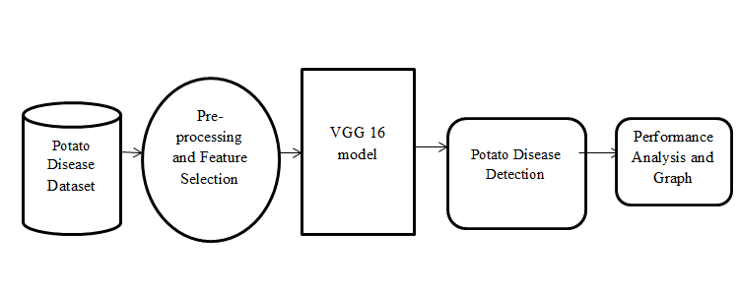
SYSTEM ARCHITECTURE

Slide 14
HARDWARE REQUIREMENTS
System : Pentium i3 Processor.
Hard Disk : 500 GB.
Monitor : 15’’ LED
Input Devices : Keyboard, Mouse
Ram : 4 GB

Slide 15
SOFTWARE REQUIREMENTS
Operating system : Windows 10.
Coding Language : Python
Web Framework : Flask

Slide 16
REFERENCE
Md. Marjanul Islam Tarik, Sadia Akter, Abdullah Al Mamun, Abdus Sattar, “Potato Disease Detection Using Machine Learning”, IEEE Conference, 2021.

